Slide 1

Mixin pattern
Krzysztof Dąbrowski
.Net Developer

Slide 2


Who is this guy?
Brief definition
Problem description
The solution - Mixins :D
History
Demo
Mixins in C#
Quiz

Slide 3

Who is this guy?
Few words about myself
Full Stack specialist in Perlica
Applied Computer Science student on PW
I dive as deep as I can in the topics of my interest
Love to learn and spread the knowledge
Dog lover

Slide 4
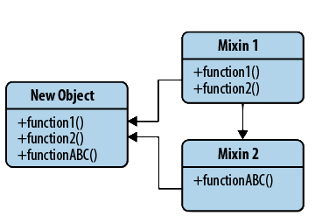
What are mixins
Add without becoming a parent
Class with methods that can be shared without being inherited
Mixins are included instead of inherited
They enable more code reuse
A bit like an interface with method implementations
Not meant to be stand alone

Slide 5
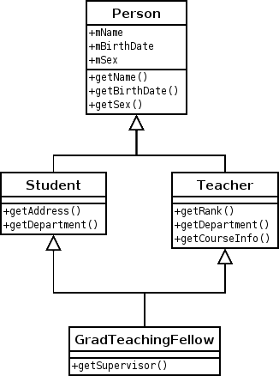
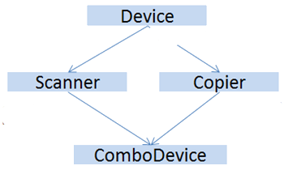
Problem to solve
Why do we need them?
Deadly Diamond of Death problem
Multiple inheritance is hard and controversial

Slide 6
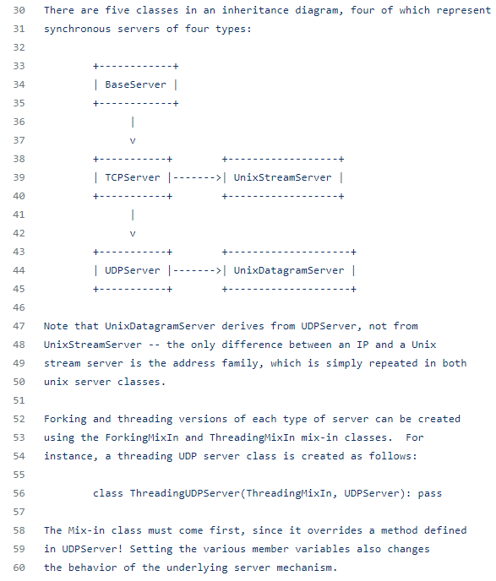
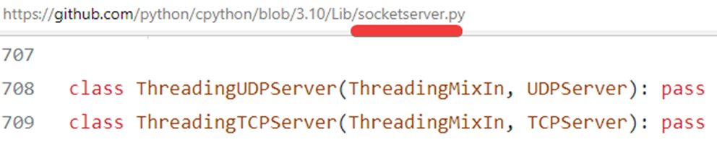
Solution - Mixins
To the rescue!
Inheriting from a mixin is not a form of specialization but is rather a means of collecting functionality
Inversion of control
Doesn’t cause the diamond problem
Mixins can contain their own state

Slide 7

History
Wher did they come from?
Steve's Ice Cream Parlor
Flavors – object-oriented extension to Lisp
The early 1980s
Traits

Slide 8
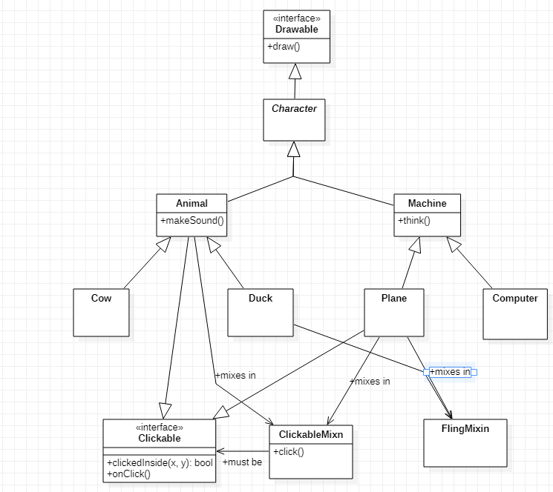
Demo – Mixins the game

Slide 9
C# Demo

Slide 10
Quiz

Slide 11
Thank you for attention!

